Slide 1
This is a test

Slide 2
Testing…
Lkja;ljg;ahgk;ajvnsdafdgargsdgdferer

Slide 3
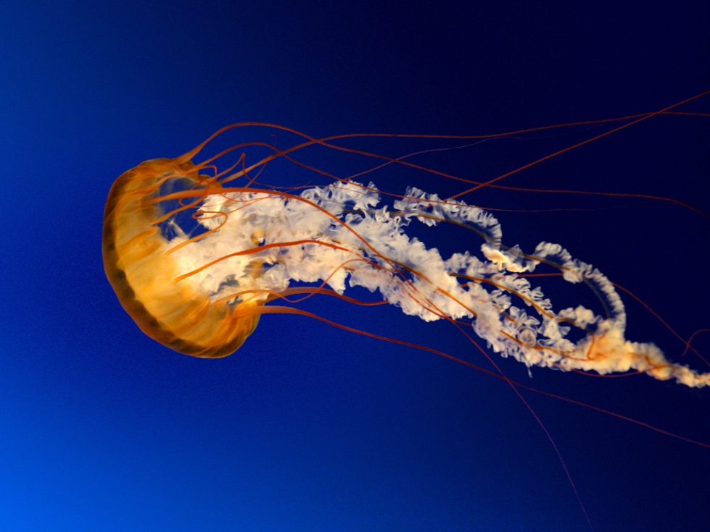
Testing2

